Slide 1
Introduction to Web Technologies
Logic & Algorithms
Lecturer: Christen Cao

Slide 2
Summary
Logical operators &&, ||, !
Associativity, Distribution & DeMorgan Laws
Truth table
Operator precedence
Examples

Slide 3

Topic 1: Logical Operators

Slide 4
Logical Operators
• and (&&), or(||) and not (!)
operands are logical values : true, false
can be used to make more advanced tests for use in
conditionals and iteration.
Enter a number, output message if it is between [2,4].
var x=Number(prompt("enter a number: "));
alert( x>=2 && x<=4 );
console.log(x<2 || x>4)

Slide 5
Topic 2: True Table

Slide 6
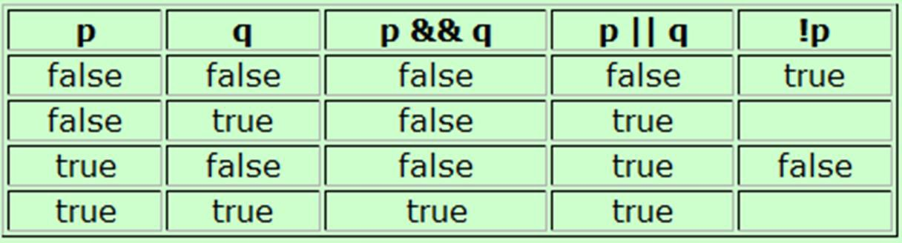
Truth Table
A chart showing the results of a logical operator for all
possible values of its operands.
p&&q is only true, if both its operands are true
p||q is true, if either of its operands are true
alert( true && false );
alert( true || false );

Slide 7
Logical Operator Rules
Associativity:
– p&&q == q&&p,
– p||q == q||p
just as x*y =y*x ; x+y = y+x
Distribution
– p && ( q || r ) == (p&&q) || (p&&r)
Just as x*(y+z) = x*y + x*z
– p || ( q && r ) == (p||q) && (p||r)
DeMorgan special rules
– !(p&&q) == !p || !q
– !(p||q) == !p && !q

Slide 8
Topic 3: Operator Precedence

Slide 9
JS operator precedence
Highest priority first row, equal precedence within a row:
( ) //Brackets: (3+4)
--, ++ //de/increment: i++
! //not: ! a
/ ,*, %
• + , -
• < ,<=, > ,>=
• ==, !=, ===, !==
• &&
• ||
• = (assign), +=, -= ,*= ,/= ,%=

Slide 10
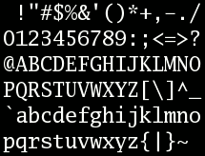
ASCII character
95 printable characters (codes 32 to 126)
start with "space" at 32
decimal digits 0-9 start at 48
26 upper case letters A-Z start at 65
26 lower case letters a-z start at 97

Slide 11
Try out: logical operators
Determine whether a character is lower case, letter, digit, vowel:
var c=prompt("enter a character:");
if( c>="a" && c<="z" )
alert("lower case letter");
if( c>="a" && c<="z" || c>="A" && c<="Z")
alert("letter");
if( "0"<=c && c<="9" )
alert("digit");
if( c=="a" || c=="e" || c=="i" || c=="o" || c=="u" ) alert("vowel");

Slide 12
Number Systems
Integer number
An integer (more commonly called an int) is a number without a decimal point
-2, 0, 500, 1024, etc.
Float number
A float is a floating-point number, which means it is a number that has a decimal place. Floats are used when more precision is needed
4.0, 3.1415, 0.000001, etc.

Slide 13
Summary
Logical operators &&, ||, !
Associativity, Distribution & DeMorgan Laws
Truth table
Operator precedence
Examples

